Slide 1

DELD
Unit 1
PN Diode and Transistor
Electronics Engineering Department

Slide 2
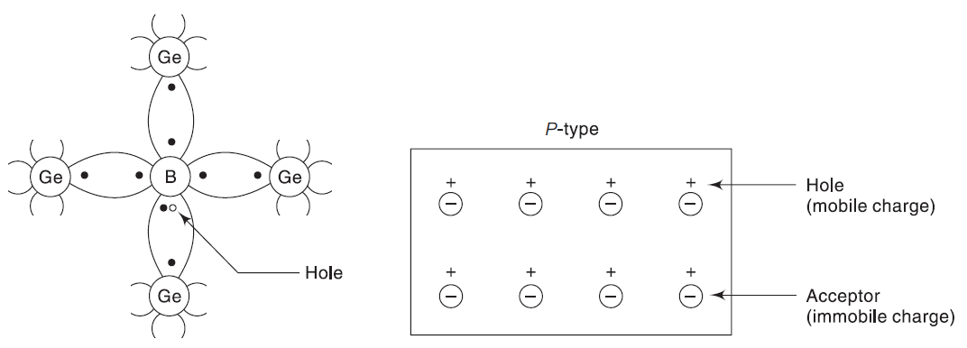
P – Type Semiconductor
Germanium doped with Boron (Trivalent Impurity)

Slide 3
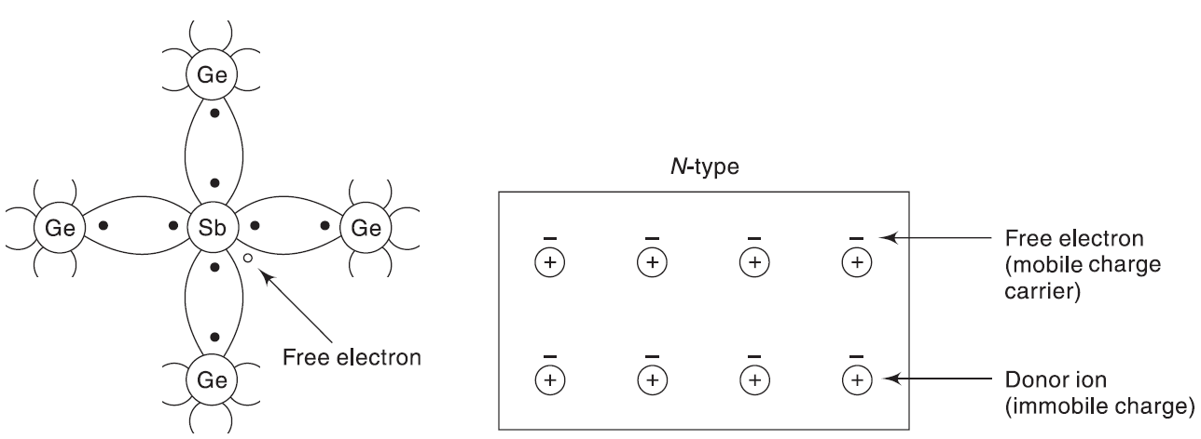
N – Type Semiconductor
Germanium doped with Antimony (Pentavalent Impurity)

Slide 4
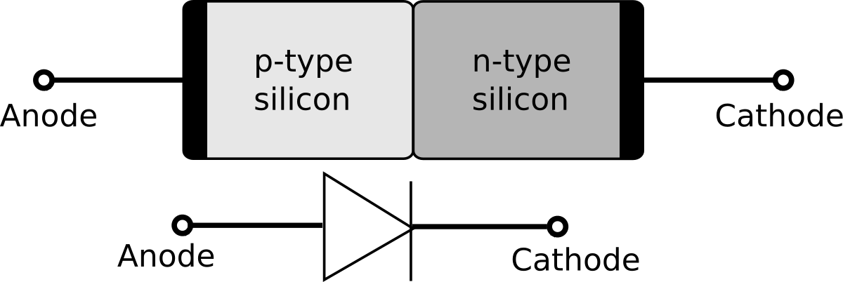
PN Junction

Slide 5
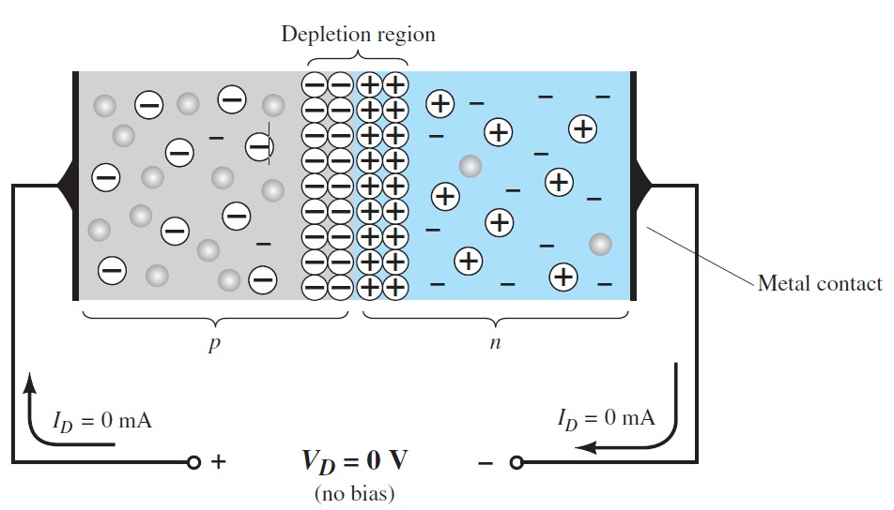
Depletion Layer

Slide 6
Depletion Layer
The excess electrons in the N- Region cross the junction and combine with the excess holes in the P – region.
N- Region looses electrons and becomes positively charged
P - Region looses holes and becomes negatively charged
At some point this migration stops (Concentration becomes same)
Any additional electrons from N side are repelled by the negative charge of the P – Region
Similarly, additional holes from the P side are repelled by the positive charge of the N –Region

Slide 7
Depletion Layer Cont…
This results in a thin layer on both the sides at the junction which contains only immobile charge carriers. This is known as depletion layer. Range is in micrometers
Width depends on doping
Heavily doped – less width and vice-versa
Electrons in the N region have to climb the potential hill in order to reach the P – Region. This potential is known as Potential Barrier.
Ge – 0.3 volts, Silicon – 0.7 volts

Slide 8
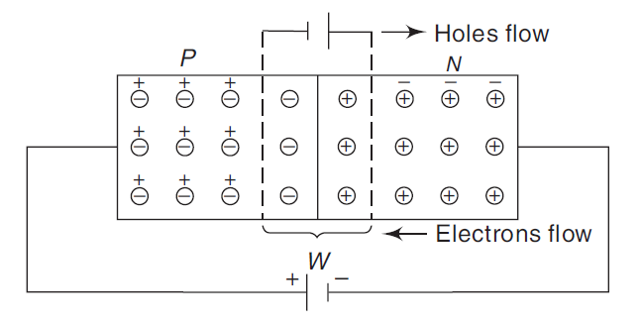
Forward Bias
Positive terminal of the battery is connected to p-region and negative terminal is connected to n-region
Width of depletion layer decreases
Current flows in the forward direction and diode acts as a short circuit

Slide 9
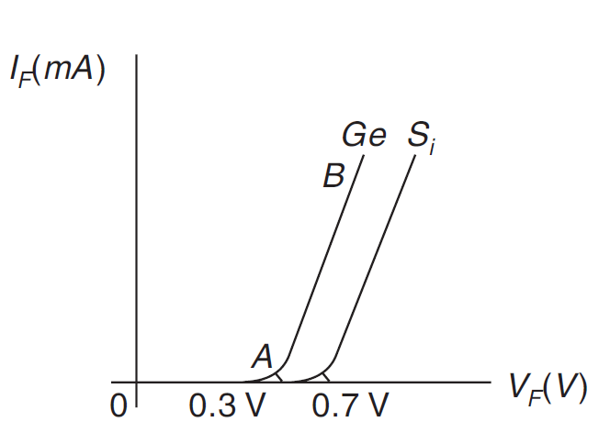
Forward Characteristics

Slide 10
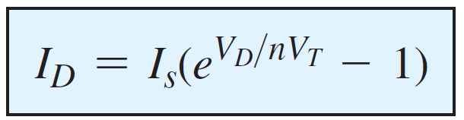
Diode Equation
Is – Reverse Saturation Current
Vd is the applied Forward Biased voltage
n – Ideality Factor (if not mentioned, assume as 1)
Vt – Thermal voltage (25 milli volts at room temperature: 27 degrees/300 degree K)

Slide 11
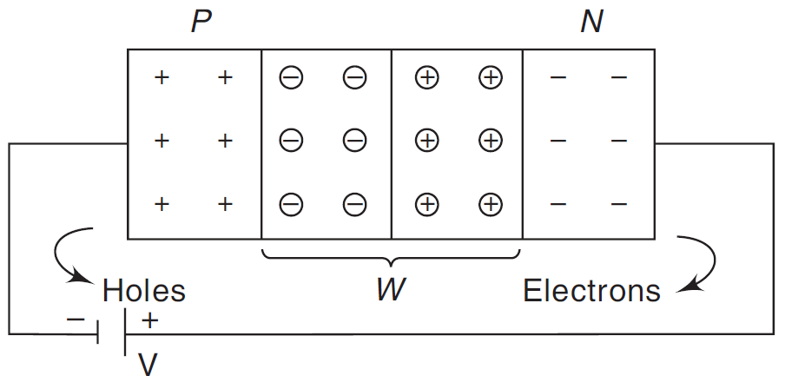
Reverse Bias
Positive terminal of the battery is connected to N – side and Negative terminal of the battery is connected to P – Side
The free electrons and the free holes are attracted back towards both the battery terminals
The charge carriers move away from the depletion layer
Width of depletion layer increases
No current flows and the diode acts as an open circuit

Slide 12
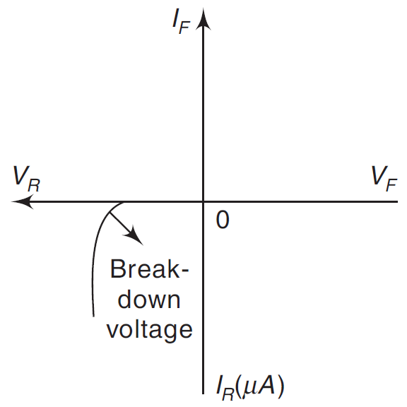
Breakdown Voltage
Go on increasing the reverse bias. At certain voltage, The current increases at a very rapid rate in a direction opposite to that of the positive voltage region.
The reverse-bias potential that results in this dramatic change in characteristics is called the Breakdown Voltage.

Slide 13
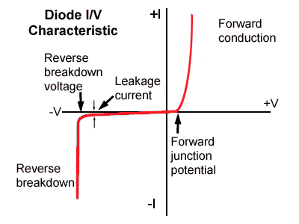
Diode Characteristics

Slide 14
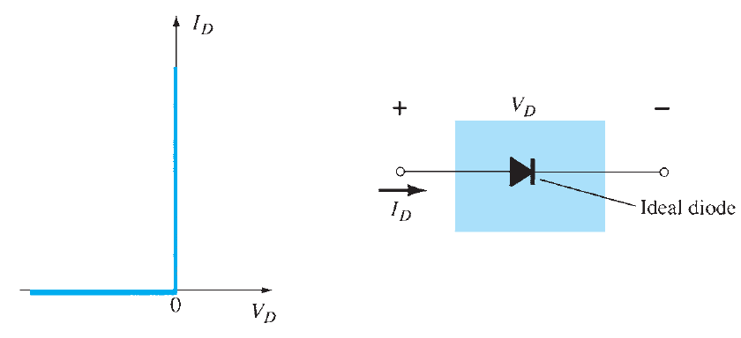
Equivalent Circuits
Ideal Diode
Diode will behave as short circuit as soon as the voltage across it becomes greater than zero

Slide 15
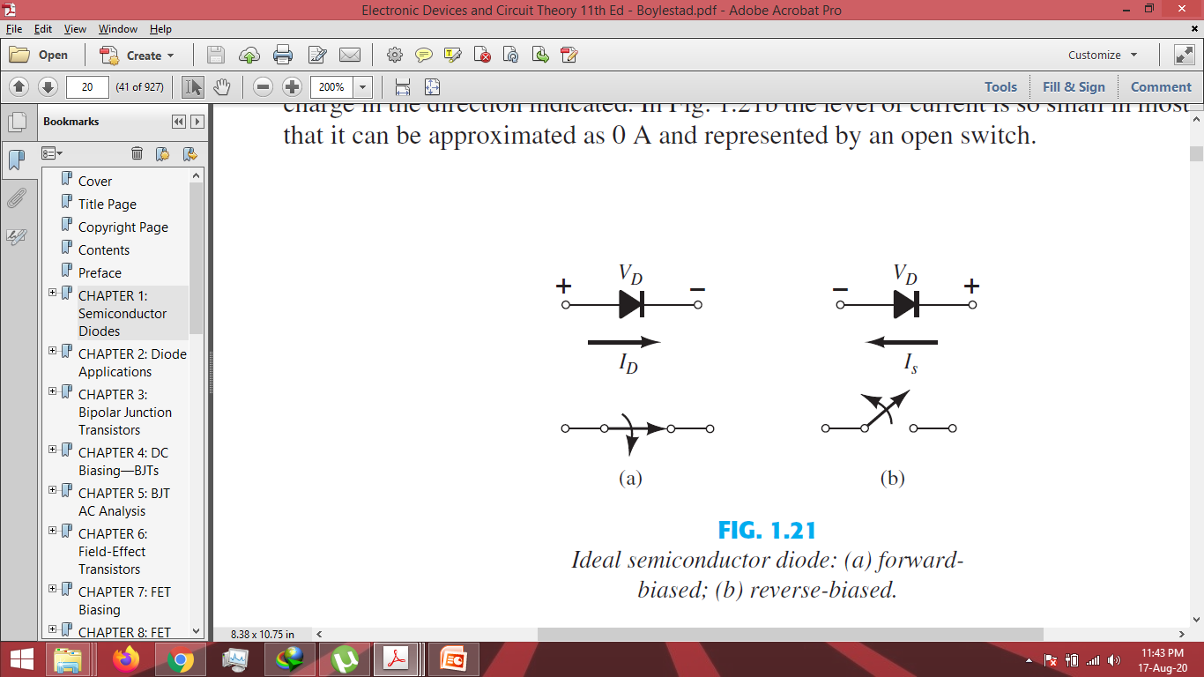

Slide 16
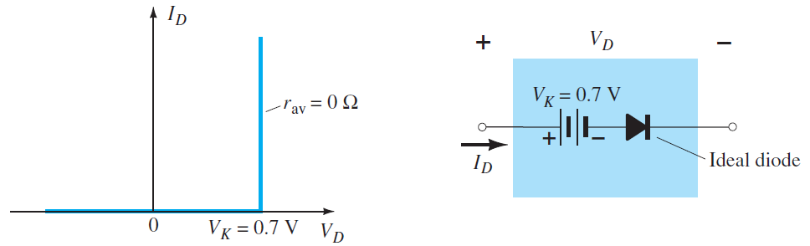
Practical Diode
We must overcome the potential barrier of 0.7 volts (silicon) for a diode to make it forward bias

Slide 17
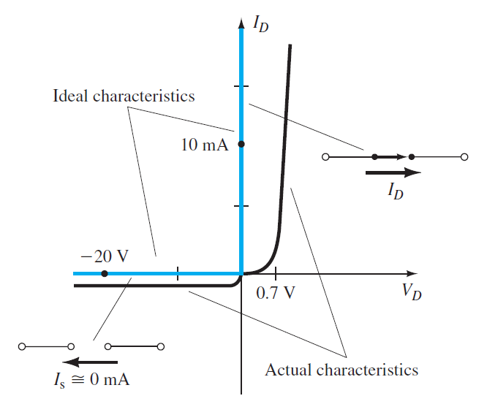
Ideal vs. Actual Characteristics

Slide 18
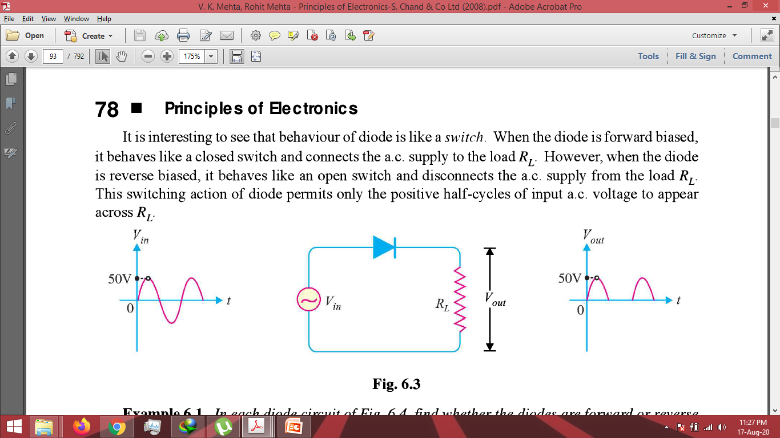
Diode as a Rectifier
Diode behaves as a switch
Forward Biased – Closed Switch, connects AC Supply to load
Reverse Biased – Open Switch, disconnects AC with load

Slide 19
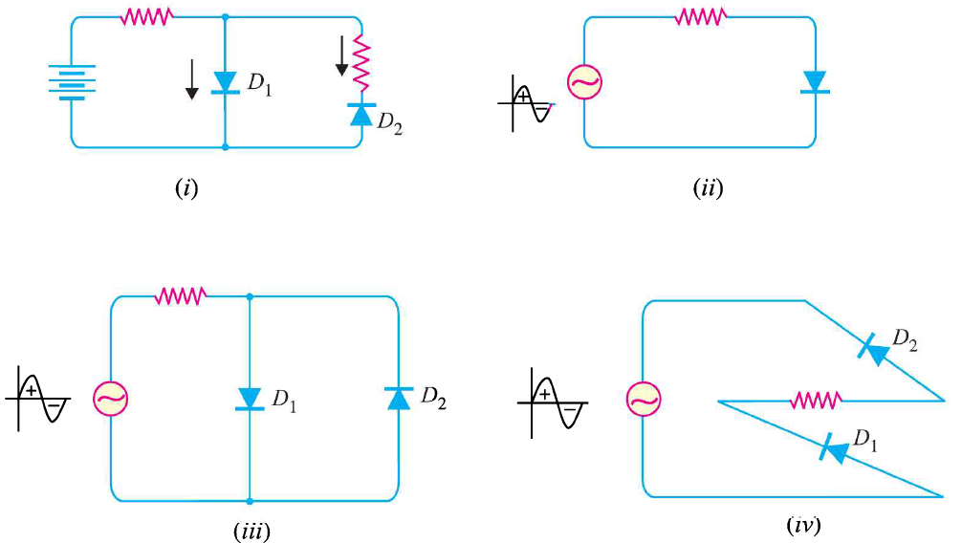
Concept Check…
Identify whether the diode/diodes is/are forward or reverse biased?

Slide 20
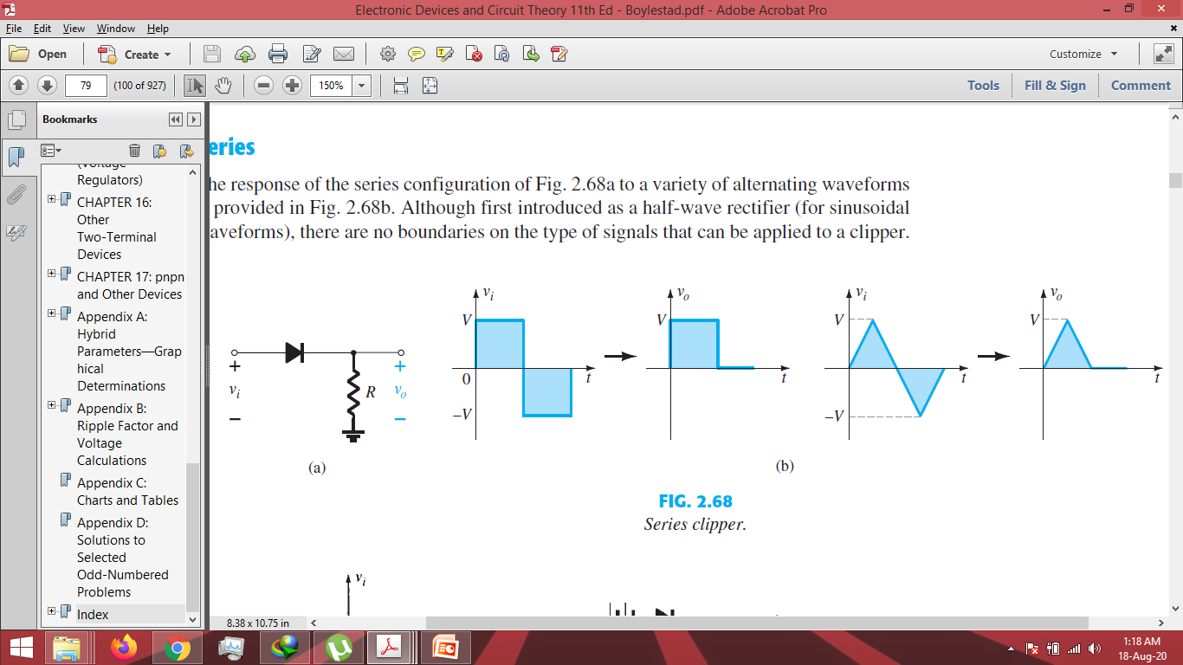
Diode as a Clipper (Series)
Clipping a portion of an input signal without distorting the remaining part of the waveform

Slide 21
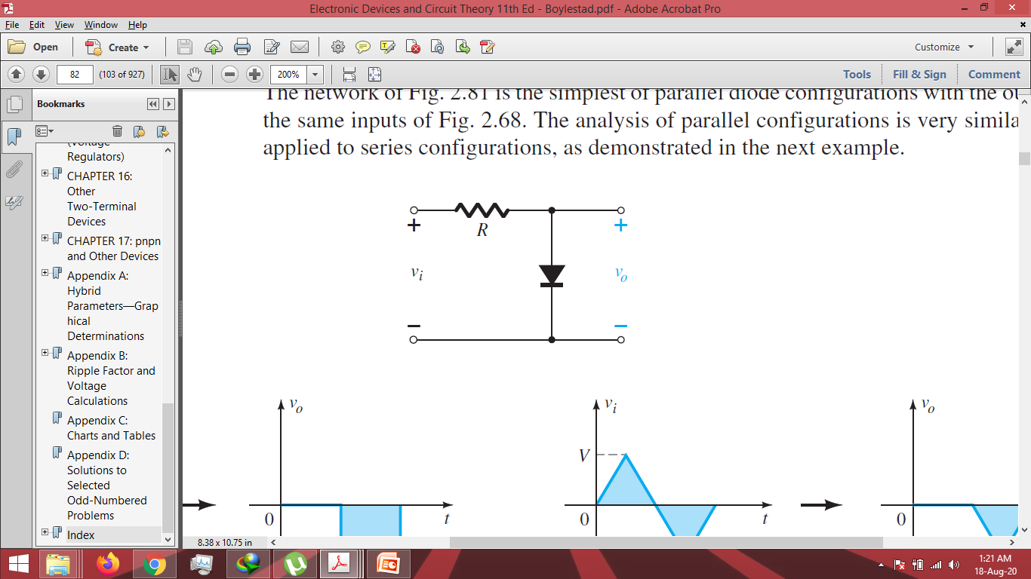
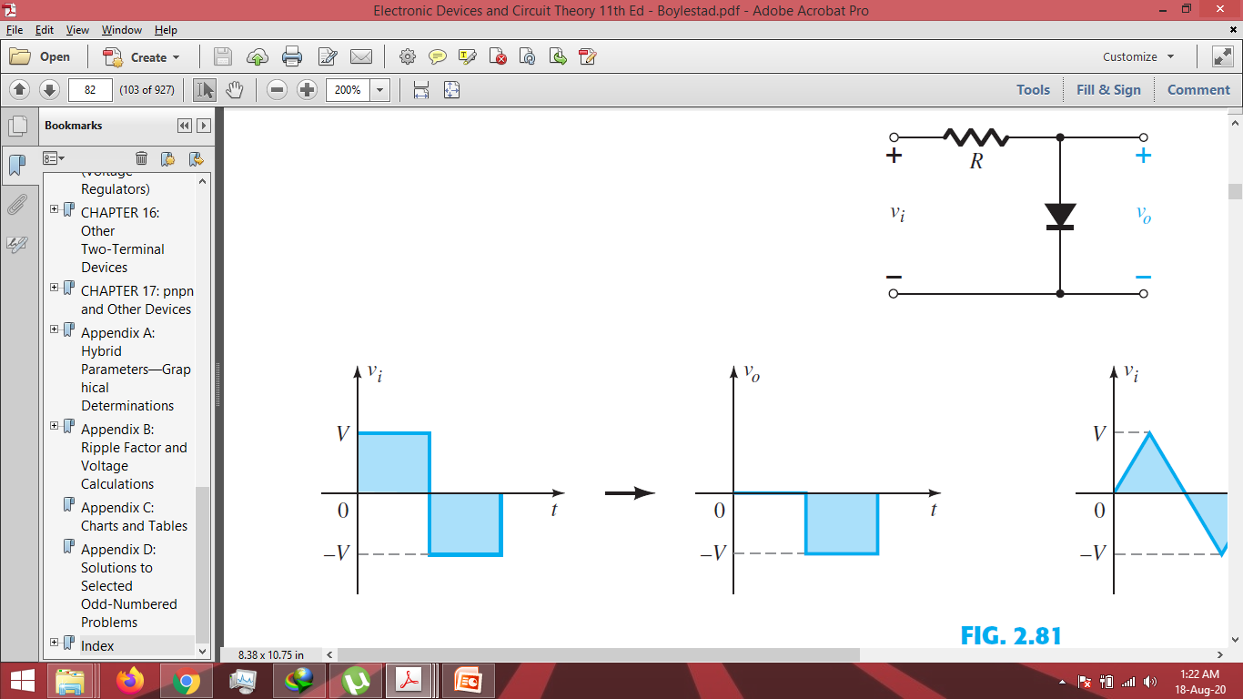
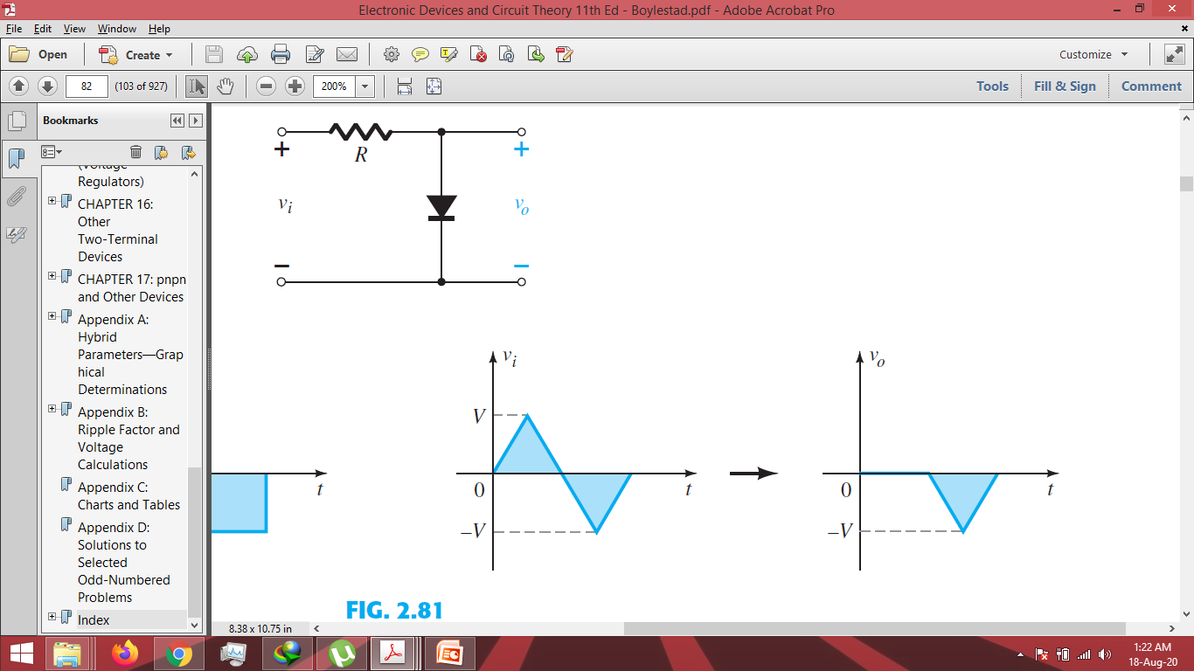
Diode as a Clipper (Parallel)

Slide 22
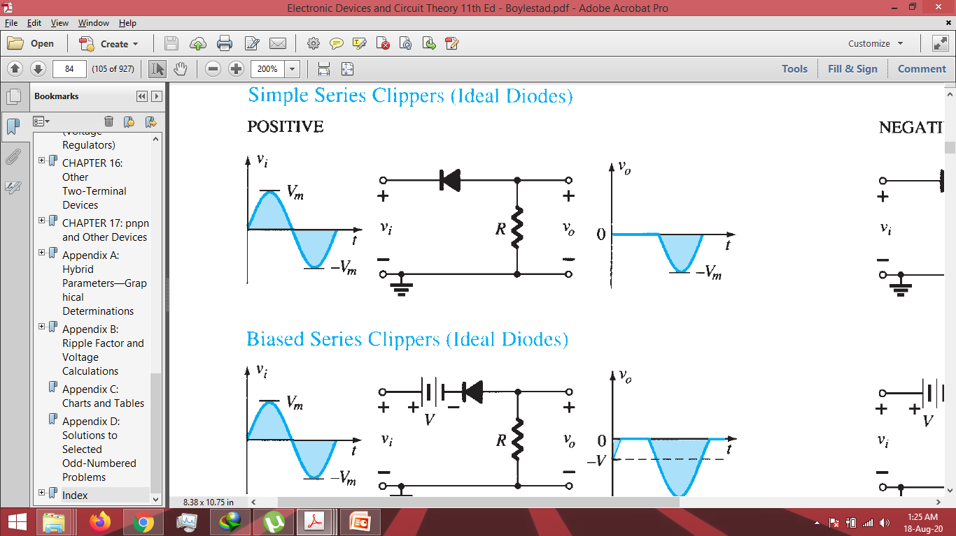
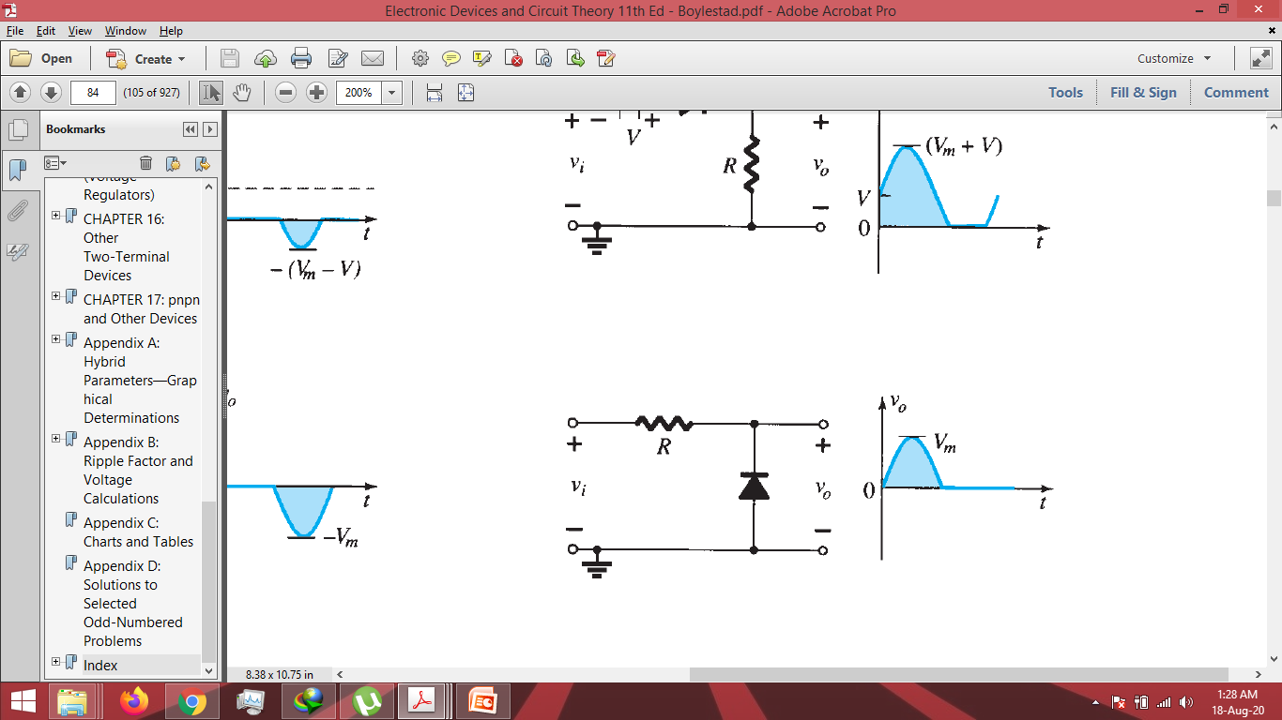
Concept Check…

Slide 23
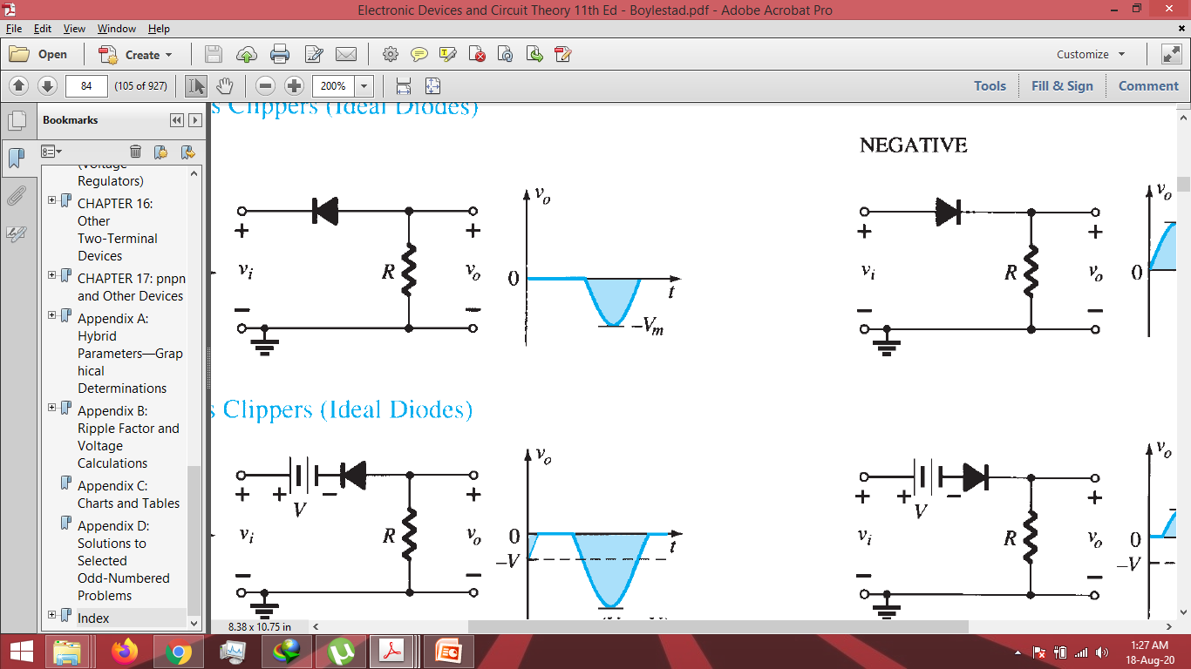
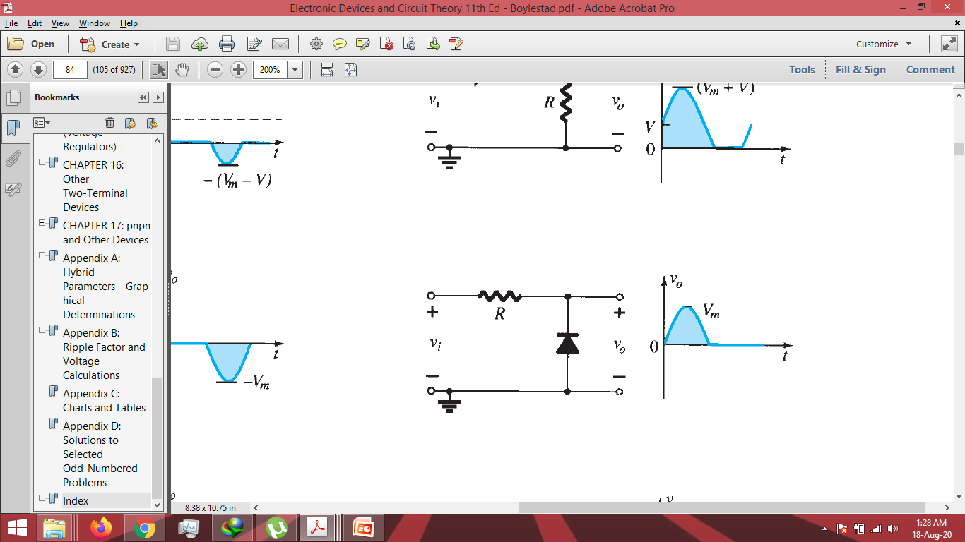
Solution

Slide 24
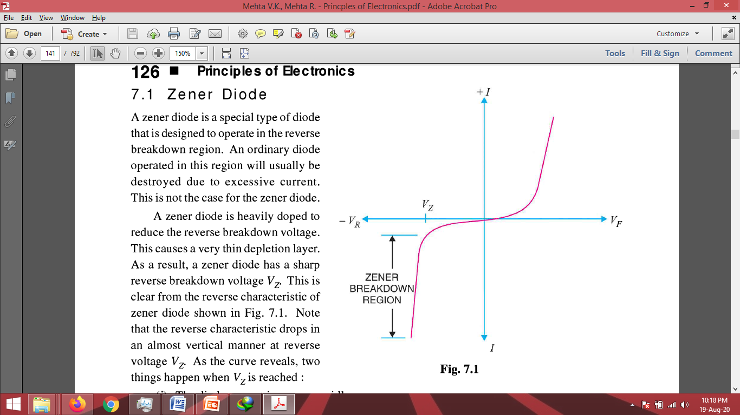
Zener Diode
A special diode designed to operate in reverse breakdown region
An ordinary diode will get damaged due to excessive current
A zener diode is heavily doped to reduce the breakdown voltage as well as depletion layer width
As a result the diode has a sharp reverse breakdown voltage
Characteristics show two imp points
After breakdown, the diode current increases rapidly
The reverse voltage across the diode remains constant.
This phenomenon of voltage remaining constant helps us to use Zener diode in voltage regulation.

Slide 25
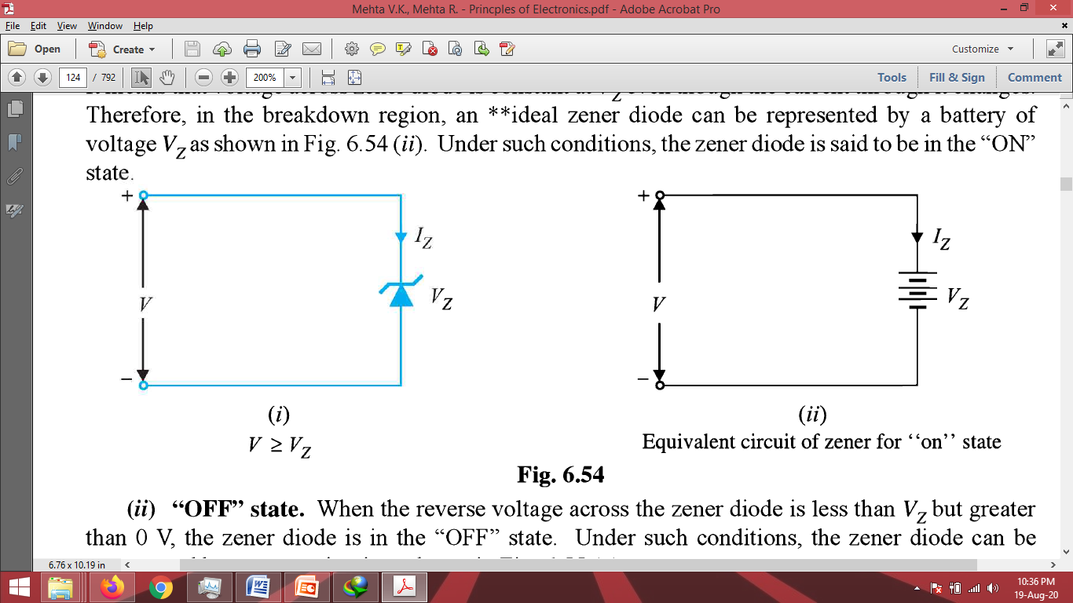
Zener Diode’s Equivalent Ckt
Always operated in reverse bias
When forward biased, will behave as a normal diode
When the reverse voltage across the diode is greater than or equal to the breakdown voltage, it can be replaced by a battery equal to the Vz (Zener Voltage or Breakdown Voltage)

Slide 26
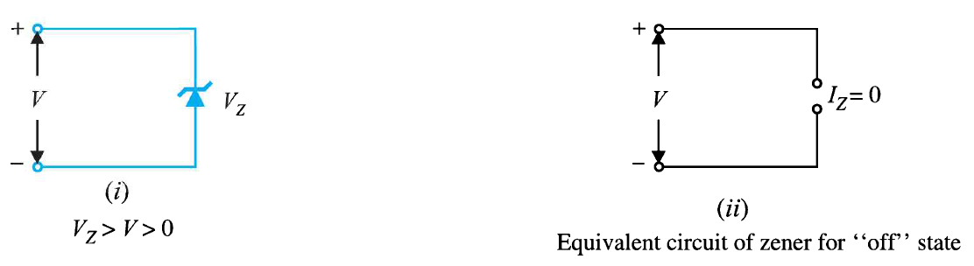
Zener Diode’s Equivalent Ckt
However if the reverse voltage is less than the breakdown voltage, it will work as open circuit as shown below.

Slide 27
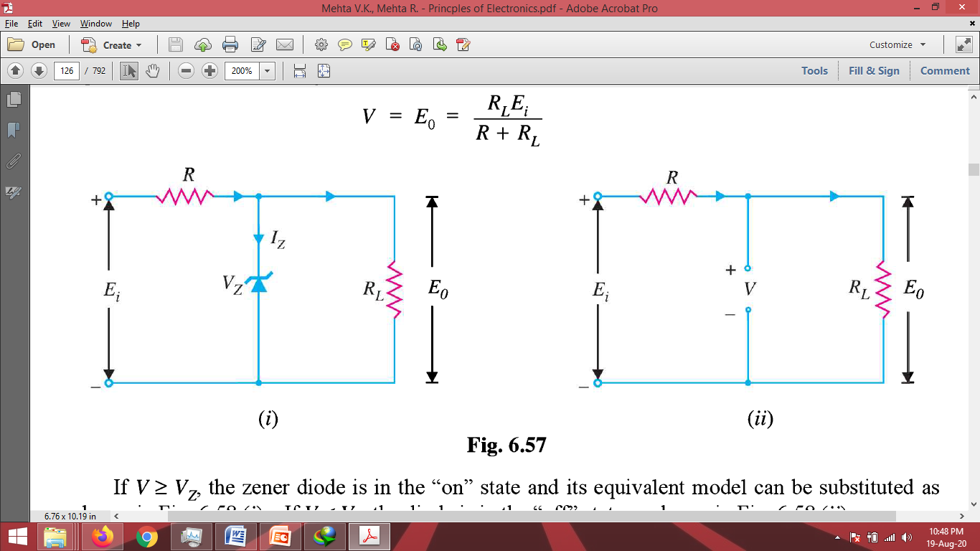
Zener Diode as a Regulator
Try to find the state of the zener diode (Off, Forward Biased, Reverse Biased, Reverse Biased and in Breakdown)
Remove the diode and find the voltage across Load Resistance
If above voltage is greater than specified breakdown voltage of zener diode than replace it by a battey of Vz. The voltage now across both diode as well as the Load resistance will remain constant at Vz.
If it less, then the replace it by an open circuit. In this case there is no regulation and the voltage across the load fluctuates as per the variations in the input power supply.

Slide 28
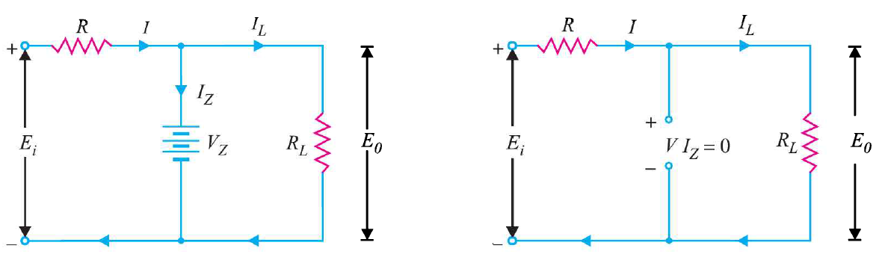
Zener Diode as a Regulator
V > Vz: Eo = Vz, Iz = I – IL, Pz = Vz. Iz, IL = Vz/RL
V < Vz: I = IL, Iz = 0, Pz = 0 (Pz = Vz.Iz), IL = Ei/(R+RL) = I

Slide 29
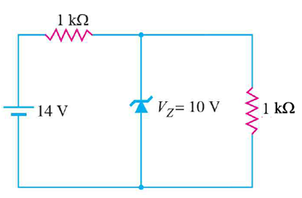
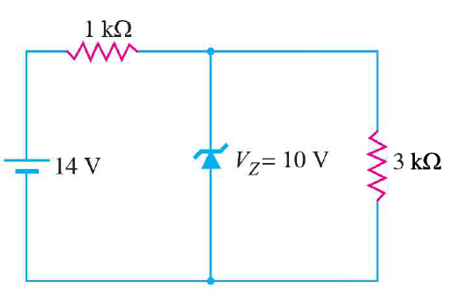
Concept Check
Determine whether Zener diode is on or off? Accordingly specify the output voltage.

Slide 30
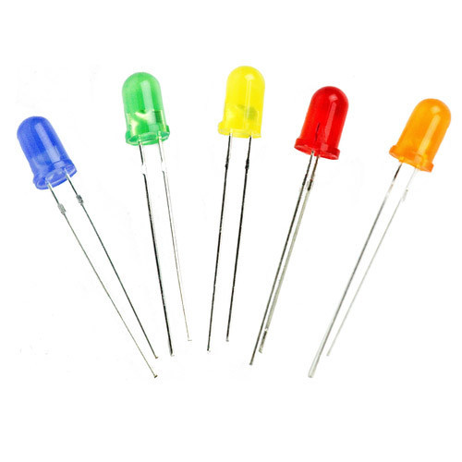
LED (Light Emitting Diode)
It is a diode which emits visible light when forward biased
Made from Gallium, Phosphorus or/and Arsenic (GaAs, GaPh, GaInPh). Changing the element and proportion changes the color.
Gallium Arsenide – Red Light
Gallium Phosphide – Green Light
When LED is forward biased, the electrons cross the junction and recombine with holes.
These electrons being in conduction band are at higher energy levels.
When they recombine, energy is released in the form of heat and light.
For Si and Ge diodes, the entire energy is given in the form of heat and the emitted light is insignificant.
For LED, the sufficient energy is emitted as light that too in the visible region.
Works as a normal diode when forward biased.

Slide 31
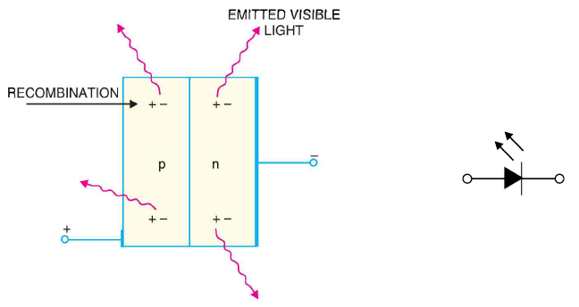
LEDs Cont…

Slide 32
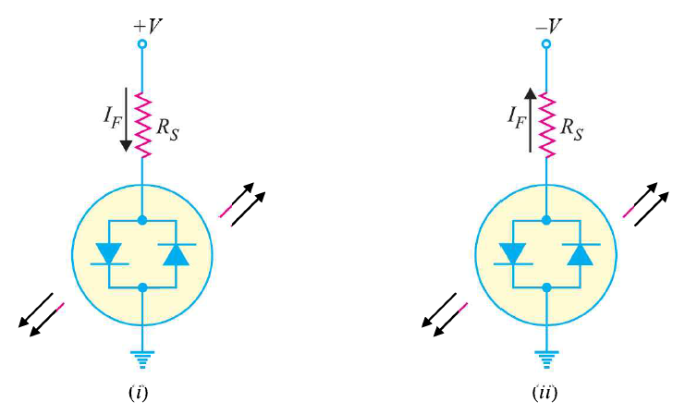
Multi-Color LEDs
These LEDs emit one color when forward biased and another when reverse biased
Comprises of two PN-junctions connected in reverse-parallel mode.
Usually when forward biased these LEDs emit RED color and when reverse biased they emit GREEN color.
If these are switched fast between the two polarities then they emit the third color. For example RED and GREEN combination will emit Yellow as third color.

Slide 33
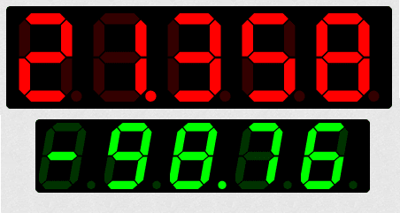
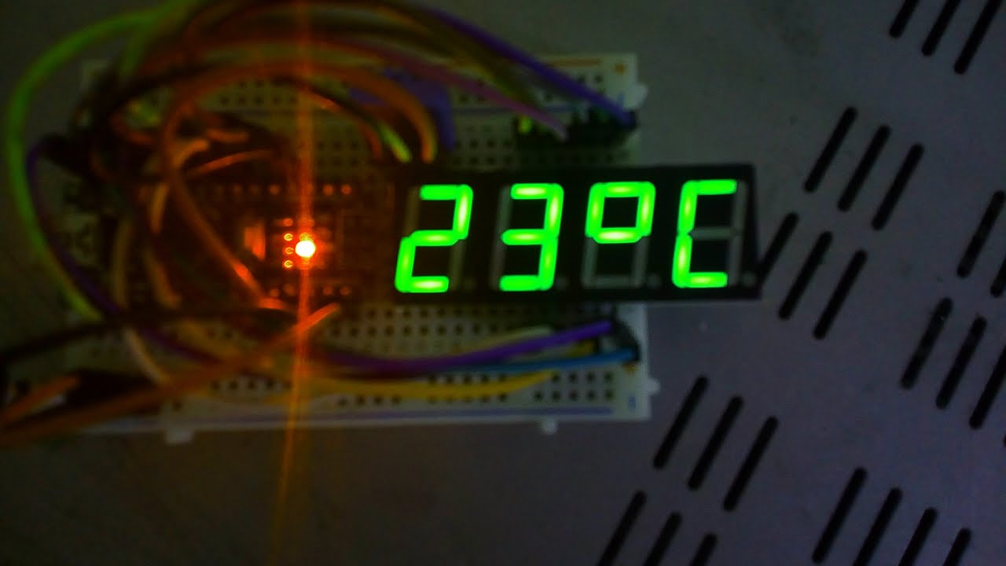
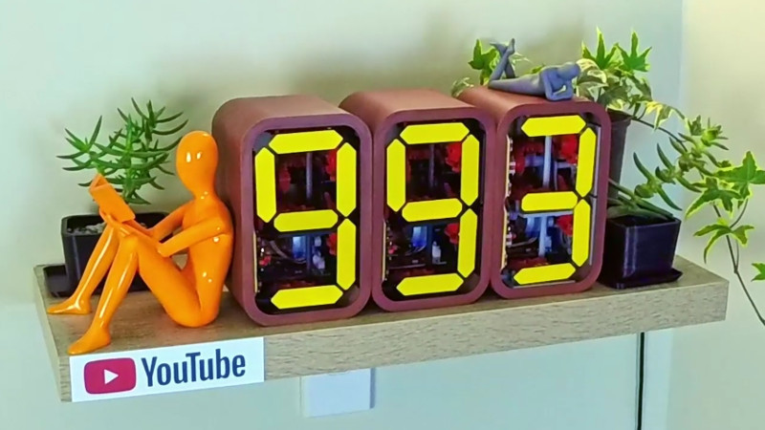
Seven Segment Display

Slide 34
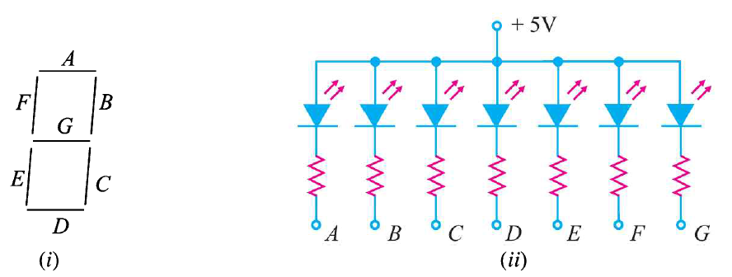
SSD Cont…
LEDs are grouped to form a Seven Segment Display
It contains seven LEDs A, B, C, D, E, F and G in shape of a figure ‘8’
If a particular LED is forward biased then that LED will glow, thereby lighting up that segment or bar.
By forward biasing various combinations of these seven LEDs, it is possible to display any number between 0 – 9.

Slide 35
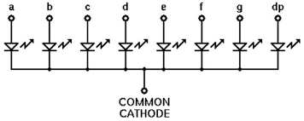
Eg. When A, B, C and D are lit, (By forward biasing them), the display will show number ‘3’
To get ‘0’ all segments except ‘G’ are lit.
In figure (ii) external resistors are included to limit current thereby preventing LEDs from damage
The configuration is referred to as Common Anode type. We also have Common Cathode type SSDs.

Slide 36
To Be Continued…

